Slide 1
Recommender Systems

Slide 2
Recommendation Systems
A recommendation Systems filters the data using different algorithms and recommends the most relevant items to users. It first captures the past behavior of a customer and based on that, recommends products which the users might be likely to buy.
For example, if you’ve recently purchased a book on Machine Learning in Python and you’ve enjoyed reading it, it’s very likely that you’ll also enjoy reading a book on Data Visualization

Slide 3
Why are Recommender Systems Important?
Recommendation systems are becoming increasingly important in today’s extremely busy world. People are always short on time with the myriad tasks they need to accomplish in the limited 24 hours. Therefore, the recommendation systems are important as they help them make the right choices, without having to expend their cognitive resources.
Here, we try to recommend the movies using some techniques or algorithms and also try to compare them since there are lot of techniques available.

Slide 4

Applications
NETFLIX
AMAZON
FACEBOOK
TWITTER
and many more...

Slide 5
Literature Survey

Slide 6
Content-Based Recommendation Systems
This paper discusses content-based recommendation systems, i.e., systems that recommend an item to a user based upon a description of the item and a profile of the user’s interests. Content-based recommendation systems may be used in a variety of domains ranging from recommending web pages, news articles, restaurants, television programs, and items for sale. Although the details of various systems differ, content-based recommendation systems share in common a means for describing the items that may be recommended, a means for creating a profile of the user that describes the types of items the user likes, and a means of comparing items to the user profile to determine what to recommend. The profile is often created and updated automatically in response to feedback on the desirability of items that have been presented to the user.

Slide 7
Item-Based Collaborative Filtering Recommendation Algorithms
Recommender systems are a powerful new technology for extracting additional value for a business from its user databases. These systems help users and items they want to buy from a business. Recommender systems benet users by enabling them to and items they like. Conversely, they help the business by generating more sales. Recommender systems are rapidly becoming a crucial tool in E-commerce on the Web. Recommender systems are being stressed by the huge volume of user data in existing corporate databases, and will be stressed even more by the increasing volume of user data available on the Web. New technologies are needed that can dramatically improve the scalability of recommender systems. In this paper we presented and experimentally evaluated a new algorithm for CF-based recommender systems. Our results show that item-based techniques hold the promise of allowing CF-based algorithms to scale to large data sets and at the same time produce high-quality recommendations.

Slide 8
Algorithms

Slide 9
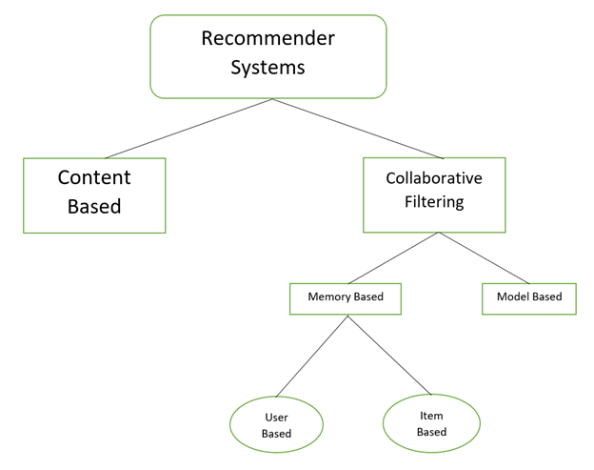
Hierarchy of Recommender System

Slide 10
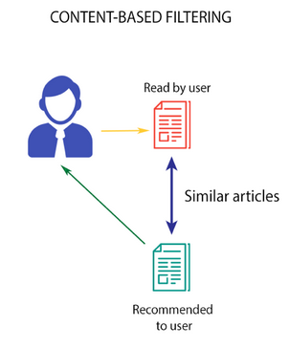
Content Based
This algorithm recommends product which are similar to the ones that user liked before
For example, if a person has liked the movie “Inception”, then this algorithm will recommend movies that fall under the same genre.

Slide 11
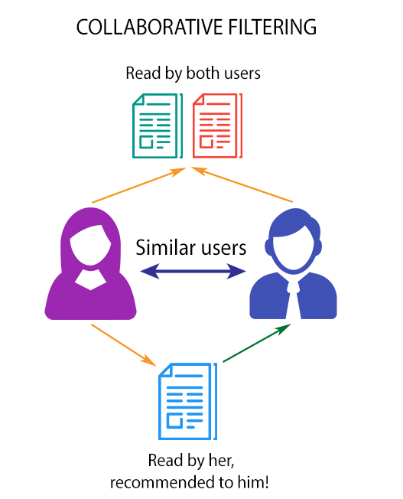
Collaborative Filtering
Collaborative filtering is based on the fact that relationships exist between products and people's interests. Many recommendation systems use collaborative filtering to find these relationships and to give an accurate recommendation of a product that the user might like or be interested in.

Slide 12
User Based Collaborative Filtering
User-Based Collaborative Filtering is a technique used to predict the items that a user might like on the basis of ratings given to that item by the other users who have similar taste with that of the target user.Many websites use collaborative for building their recommendation system. We are using Pearson correlation for recommending the movies.

Slide 13
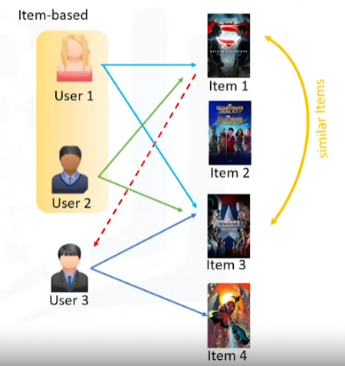
Item-to-Item Based Collaborative Filtering
It was first invented and used by Amazon in 1998. Rather than matching the user to similar customers, item-to-item collaborative filtering matches each of the user’s purchased and rated items to similar items, then combines those similar items into a recommendation list.

Slide 14
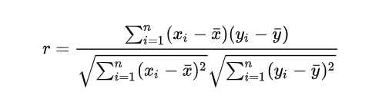
Pearson Correlation
Pearson correlation is invariant to scaling, i.e. multiplying all elements by a nonzero constant or adding any constant to all elements. For example, if you have two vectors X and Y,then, pearson(X, Y) == pearson(X, 2 * Y + 3). This is a pretty important property in recommendation systems because for example two users might rate two series of items totally different in terms of absolute rates, but they would be similar users (i.e. with similar ideas) with similar rates in various scale

Slide 15
Results

Slide 16
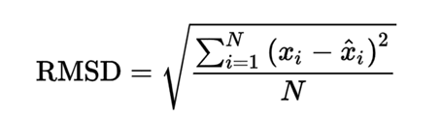
What is RMSE
Root Mean Square Error (RMSE) is a standard way to measure the error of a model in predicting quantitative data. Lower values of RMSE indicate better fit. RMSE is a good measure of how accurately the model predicts the response, and it is the most important criterion for fit if the main purpose of the model is prediction. Lower values of RMSE indicate better fit. RMSE is a good measure of how accurately the model predicts the response, and it is the most important criterion for fit if the main purpose of the model is prediction.

Slide 17
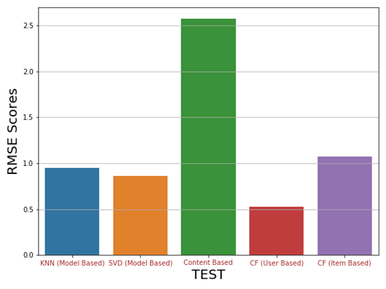
Bar Chart of RMSE Scores

Slide 18
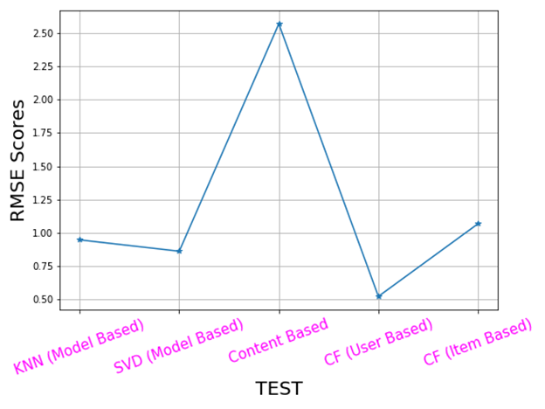
Line Chart of RMSE Values

Slide 19
Result

Slide 20
Results
As expected, the Content Based Filtering gives us the least performance with a RMSE value of 2.5 approximately since doesn’t take into account what other user think of the movie, so low quality recommendations might happen.
All other algorithms gave a good score of RMSE value compare to content based recommender system.
Collaborative Filtering (User Based) provided us with the best RMSE score which is around 0.42 which is least among all the other algorithms performed since it takes other user’s ratings also into consideration and it adapts to the user;s interests which might change over time.

Slide 21
Conclusion
All in all, recommender systems can be a powerful tool for any Movie Recommendation, and rapid future developments in the field will increase their business value even further.
In this project we tried to recommend movies based on Movie Lens data set On successful evaluation of all our algorithms using RMSE we can concluded that Collaborative Filtering (User Based) is best algorithm for recommendation system.
The best RMSE score we could get for User Based algorithm is ~ 0.52.

Slide 22
Thank You

